Slide 1
Working with Heroku

Slide 2


About me - Alain Chautard (or just Al)
Google Developer Expert in Web technologies / Angular / maps platform Web consultant (60%) / trainer (40% of the time) Organizer of the Sacramento Angular Meetup group
Published author / international conference speaker
Heroku user

Slide 3
Quick Poll
How many of you are developers?
How many of you are working on dev-ops?
Any experience with Heroku?
Ever created an app / pipeline with Heroku?
Any experience with another hosting solution?

Slide 4
How we're going to work
Your questions are welcome, anytime!
Feel free to come up with questions related to specific problems you’re trying to solve with Heroku. We might even try to fix those problems together.
My goal is to give you the tools to work efficiently with Heroku - We’re going to practice a lot!
As a result, we will be going through online documentation when needed

Slide 5
Useful links
Link to these slides:
https://bit.ly/di-heroku
Breaks: 5 mins every hour - 12pm Pacific (1 hour)

Slide 6
Outline for today
Overview of Heroku
Introduction to Git and GitHub Deploying your applications using Heroku
Scaling your applications with Heroku Dynos
Heroku Connect Continuous Integration and Continuous Deployment with Heroku Supporting Heroku applications

Slide 7
Outline for today
Overview of Heroku
Introduction to Git and GitHub Deploying your applications using Heroku
Scaling your applications with Heroku Dynos
Heroku Connect Continuous Integration and Continuous Deployment with Heroku Supporting Heroku applications

Slide 8
Overview of Heroku

Slide 9
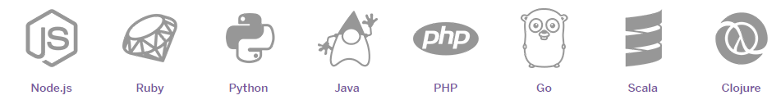
Introduction to Heroku
Heroku is a cloud platform as a service (PaaS) supporting several programming languages.
Launched in 2007, it initially supported Ruby only, but now supports all of the following languages:

Slide 10
Why PaaS?
Services to develop, test, deploy, host, and maintain applications in the same integrated environment
Web-based user interface creation tools used to create, modify, test, and deploy different scenarios
Multitenant architecture in which multiple concurrent users use the same application
Built-in scalability of deployed software, including load balancing and failover
Integration with web services and databases via common standards
Support for development team collaboration
Tools to handle billing and subscription management

Slide 11
Why Heroku?
Heroku is using AWS (Amazon Web Services), the most popular cloud-platform to date
Instead of managing our own data-centers (which means lots of hardware and software), we rely on heroku to do it all for us
When we deploy an app to Heroku, it packages the app’s code and dependencies into lightweight, isolated environments known as containers
Each container has it own filesystem, memory, and CPU allocation. It can be created on-demand for scalability or shutdown when the application is not used
In Heroku, containers are called dynos

Slide 12
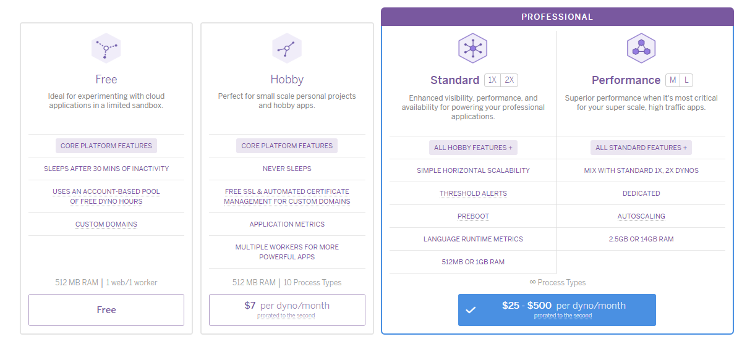
Heroku offers a lot of flexibility for its dynos

Slide 13
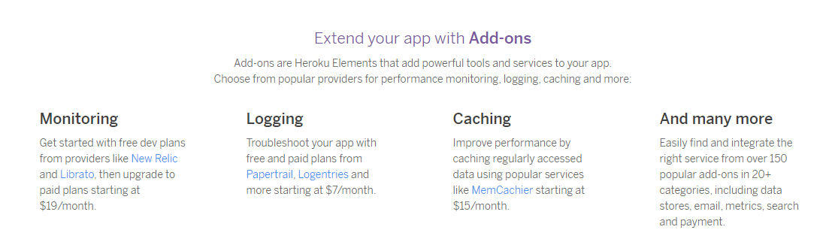
Heroku also has add-ons to enable extra features
As with all-things Heroku, you can start with free tiers and later on pick some add-ons as your application grows and requires more tooling:

Slide 14
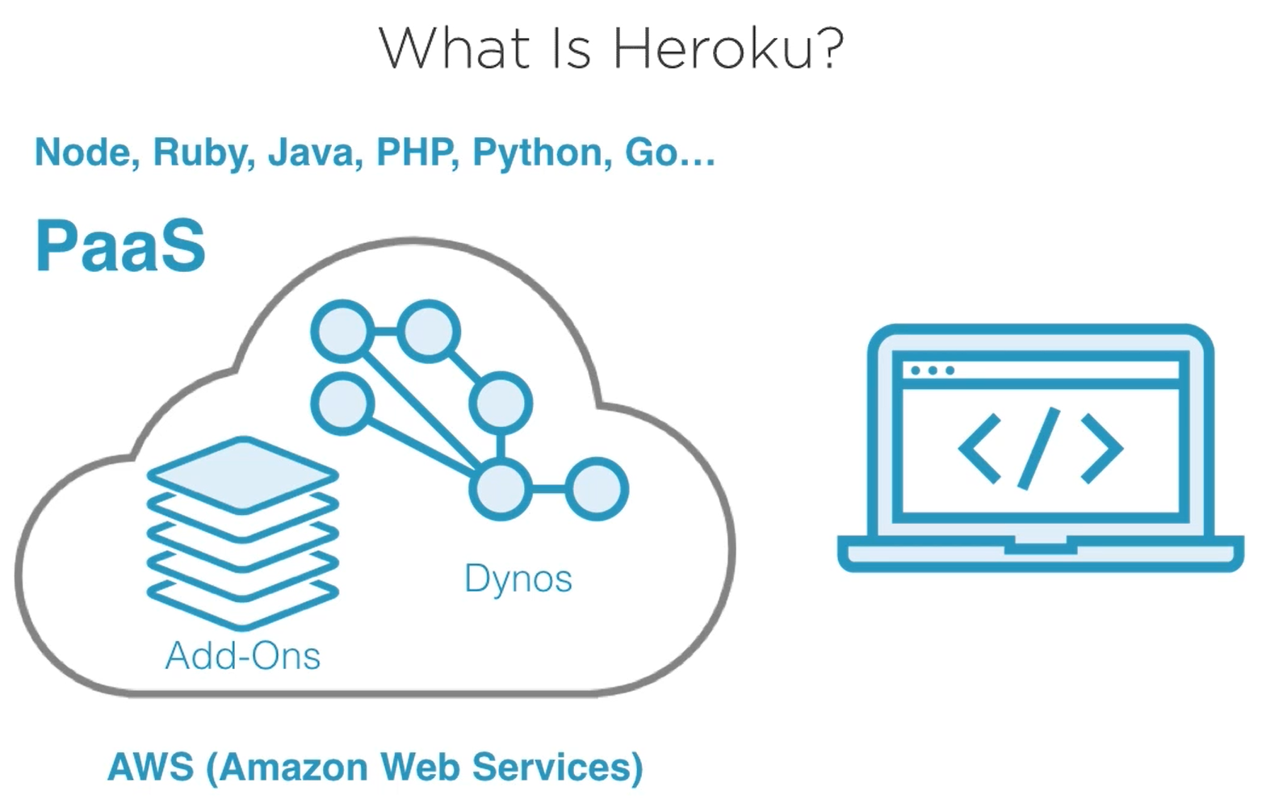
Summary

Slide 15
How does Heroku work?
The main idea behind Heroku is to handle all of the steps that have to happen to build, deploy, and run some code in production
Heroku will handle all of these steps - and more:
Get latest code => Build it => Release it => Run it in a dyno => Scale it
We’ll see that we can change how Heroku handles any of these steps, as well as add extra steps to that basic process

Slide 16

Lab 1: Creating a Heroku account
In this lab, we’re going to create a Heroku account to use throughout this training
Your mission: Head to https://www.heroku.com/ and click on the “Sign up for free” button
Fill out the information in the sign up form. Note that the development language you choose there does not matter in the end.
Create the account and head to your email inbox to validate your email address. You should be able to sign in now.

Slide 17
Outline for today
Overview of Heroku
Introduction to Git and GitHub Deploying your applications using Heroku
Scaling your applications with Heroku Dynos
Heroku Connect Continuous Integration and Continuous Deployment with Heroku Supporting Heroku applications

Slide 18
Introduction to Git
and GitHub

Slide 19

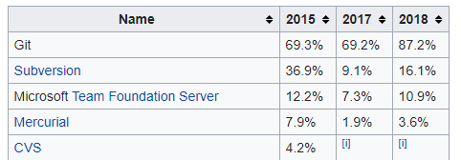
Introduction to Git
Git is a distributed version-control system for tracking changes in source code during software development.
It quickly became the most popular version-control system over the years:

Slide 20
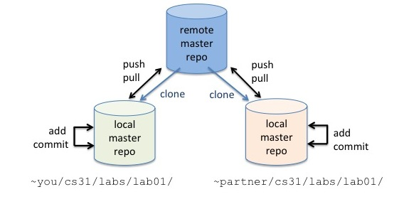
Introduction to Git
What makes Git powerful (and complex at the same time) is that it relies on both a remote and a local code repository.
Developers would first clone a remote repository to have their own local version of it. Then they can make changes to the code, add and commit those changes to their local repository, then push those changes to the remote repository.

Slide 21

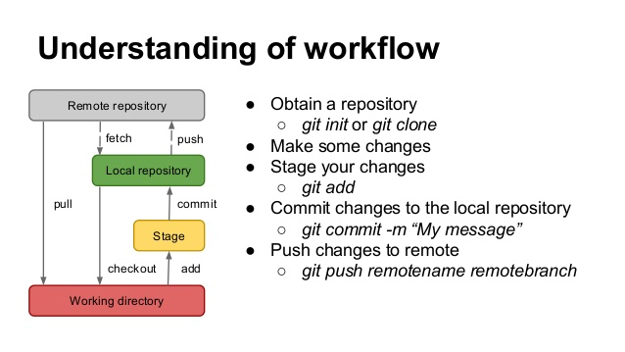
Git Workflow
Interactions with Git happen through terminal commands such as git clone
There are also user interfaces such as Sourcetree that make that process easier.

Slide 22
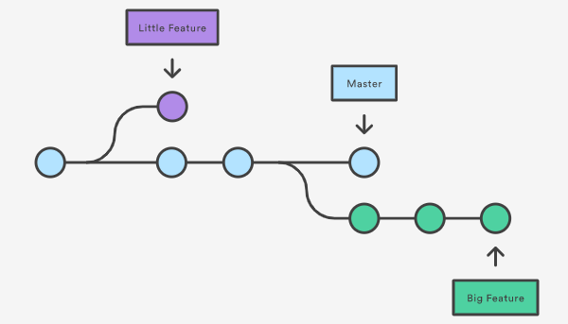
Git Workflow - Additional concepts and vocabulary
Enterprise software companies and open-source frameworks usually don’t allow individual developers to change the master remote repository directly.
Instead, developers work on branches of that repository.
Once a developer is done with work on their branch, they create a pull request for those changes to be merged into the master repository

Slide 23


Introduction to GitHub
GitHub provides hosting for software development version control using Git as well as SVN.
In other words, Git is the tool to manage code repositories, and GitHub is a hosting service for those repositories.
As of January 2020, GitHub reports having over 40 million users and more than 100 million repositories (including at least 28 million public repositories), making it the largest host of source code in the world.

Slide 24
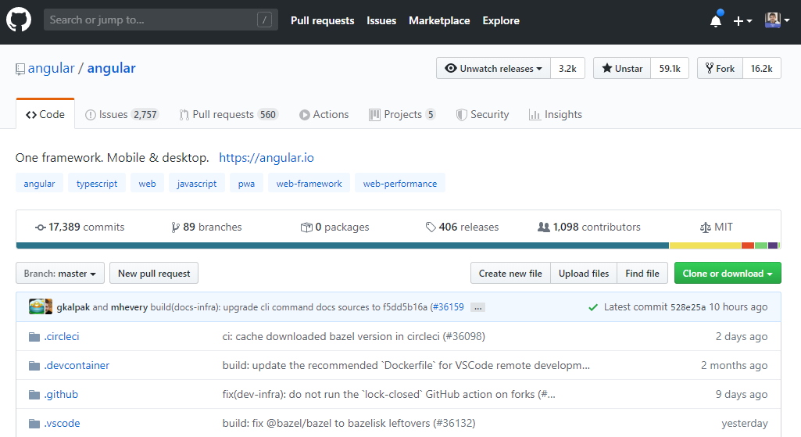
GitHub: Guided tour

Slide 25
Lab 2 - Working with Git and GitHub
In this lab, we’re going to install Git and clone a code repository.
Your mission: In order to run Git on your machine, first install it from: https://git-scm.com/downloads
Once installed, create a new folder on your machine. For instance: C:\sources\test
Open a terminal in that new folder and run: git clone https://github.com/alcfeoh/lp-store-server.git
The above command created a clone of the remote repository from GitHub into your local folder. Explore that folder to see the files that got downloaded.

Slide 26
Outline for today
Overview of Heroku
Introduction to Git and GitHub Deploying your applications using Heroku
Scaling your applications with Heroku Dynos
Heroku Connect Continuous Integration and Continuous Deployment with Heroku Supporting Heroku applications

Slide 27
Deploying your applications using Heroku

Slide 28
Introduction to the Heroku CLI
Heroku CLI is a Command Line Interface for Heroku
It’s an essential part of using Heroku as it can help you create scripts that automate several commands to deploy code to production
CLI works on iOS, Windows, Ubuntu, as well as any Node.JS compatible environment.

Slide 29
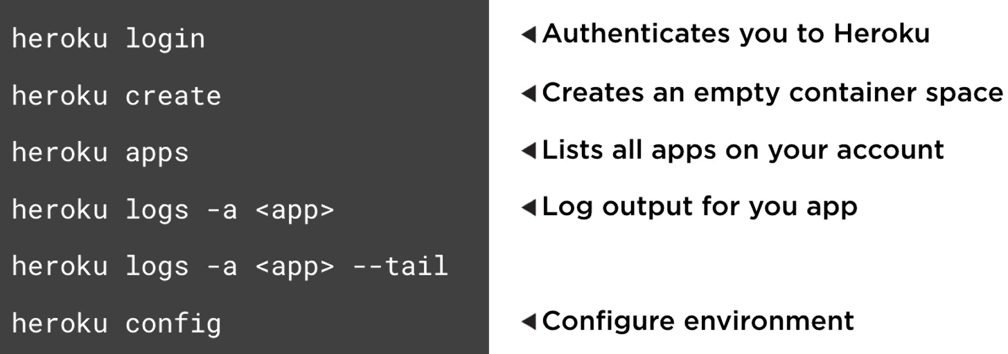
Heroku CLI: A few examples of commands

Slide 30
Lab 3 - Working with Heroku CLI
In this lab, we’re going to install Heroku CLI and deploy our sample application
Your mission: Install Heroku CLI on your machine by following the instructions at: https://devcenter.heroku.com/articles/heroku-cli
Open a terminal in the folder used to clone the code repo in lab #2
Run the command: heroku login and enter your credentials
Then run the command: heroku create to create a new Heroku app
Then run: git push heroku to push our code to our new Heroku Git repo
The application is now deployed. Head to https://dashboard.heroku.com/ to explore your new app on Heroku

Slide 31
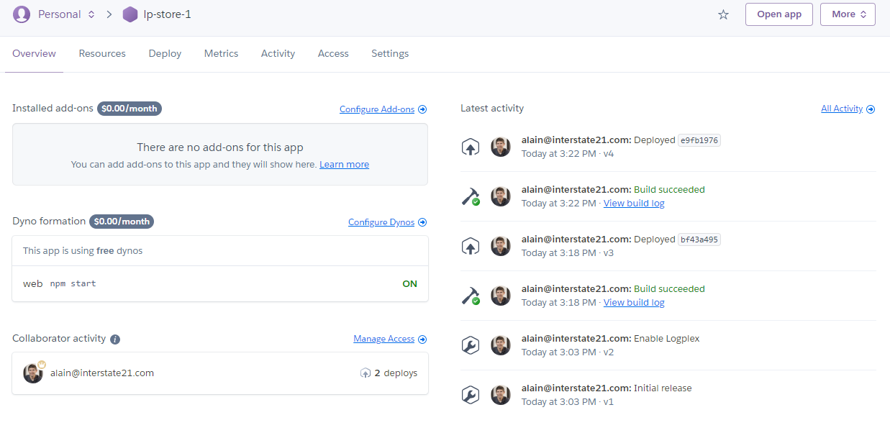
Heroku Dashboard
Let’s explore the Heroku Dashboard together

Slide 32
Heroku CLI demo
Let’s try some commands together:
heroku apps
heroku logs -a [app-name]
heroku logs -a [app-name] --tail
heroku ps

Slide 33
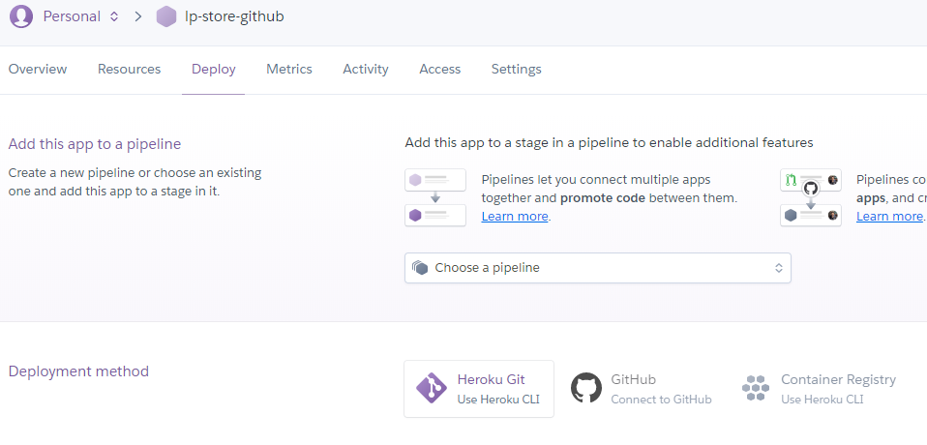
Using Heroku with GitHub
Instead of using a local clone of a repo, a Git repo on Heroku, and Heroku CLI to sync all of these pieces together, the process can be simplified with GitHub
It is possible to create a new app directly with the Heroku Web App and then connect the app to a GitHub repo - as well as set up auto-deploy:

Slide 34
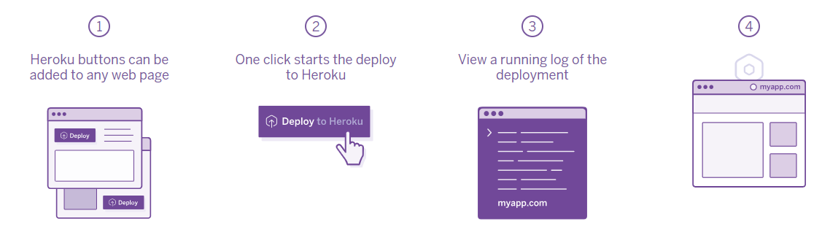
Heroku Buttons
Heroku Buttons are a way to deploy an application in one-click
They can be added to any webpage and deploy any kind of GitHub repo, public or private

Slide 35
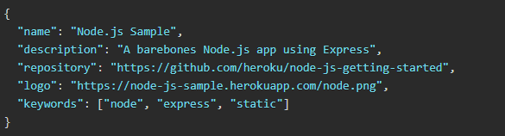
How to create a Heroku Button?
Add a file called app.json at the root of your GitHub repo. Add a name, description, and repository URL into it:
Then use the following HTML code to render a button that points to the code repository defined in app.json: <a href="https://heroku.com/deploy?template=https://github.com/heroku/node-js-getting-started">
<img src="https://www.herokucdn.com/deploy/button.svg" alt="Deploy">
</a>

Slide 36
Lab 4 - Creating and using a Heroku Button
In this lab, we’re going to try a Heroku Button and create our own
Your mission: Open https://github.com/alcfeoh/lp-store-server in a browser, scroll to the end of the page and click the Heroku button to deploy the app
Now let’s create a custom Heroku Button. Create a file called index.html in the folder of your choice.
Edit index.html with a text editor and add the following code in it: <a href="https://heroku.com/deploy?template=https://github.com/alcfeoh/lp-store-server"> <img src="https://www.herokucdn.com/deploy/button.svg" alt="Deploy"> </a>
Open index.html in a browser and click the Heroku button to see what happens

Slide 37
Heroku Buildpacks
What we’ve done so far might look like magic: Our app was already set-up to be “Heroku-friendly”
In some cases, you might have to “teach” Heroku how to build and deploy your application
Buildpacks are responsible for transforming deployed code into a slug, which can then be executed on a dyno. Buildpacks are composed of a set of scripts that turn your code into compiled code that can then be deployed
Heroku has its own set of buildpacks for the languages it supports, as well as several third-party buildpacks : https://elements.heroku.com/buildpacks

Slide 38
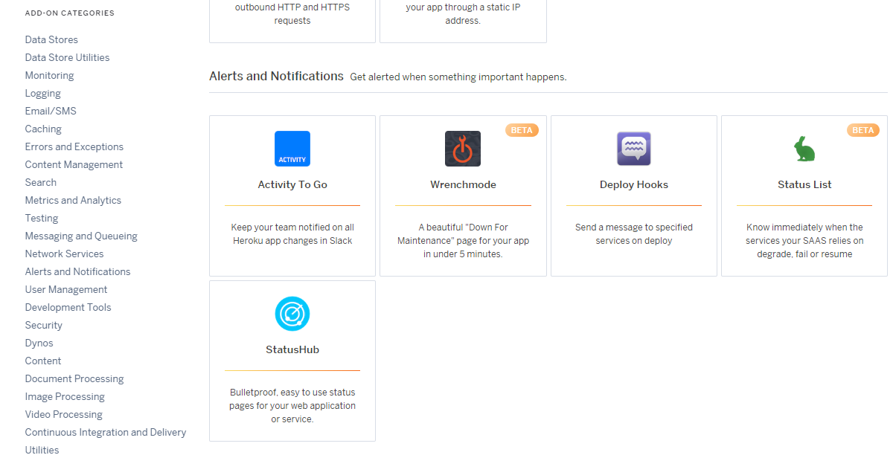
Heroku Add-Ons
Add-Ons can be used to improve your Heroku experience and add features to your app
There are dozen of add-ons you can choose from at https://elements.heroku.com/addons

Slide 39
Outline for today
Overview of Heroku
Introduction to Git and GitHub Deploying your applications using Heroku
Scaling your applications with Heroku Dynos
Heroku Connect Continuous Integration and Continuous Deployment with Heroku Supporting Heroku applications

Slide 40
Scaling your application with Heroku dynos

Slide 41
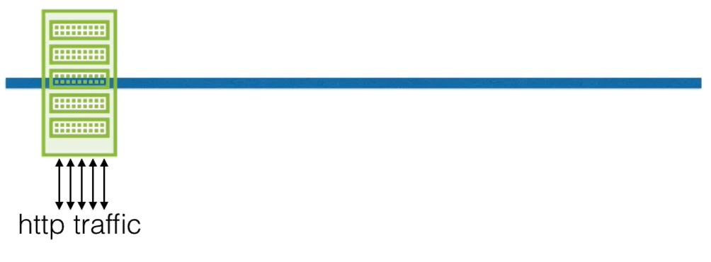
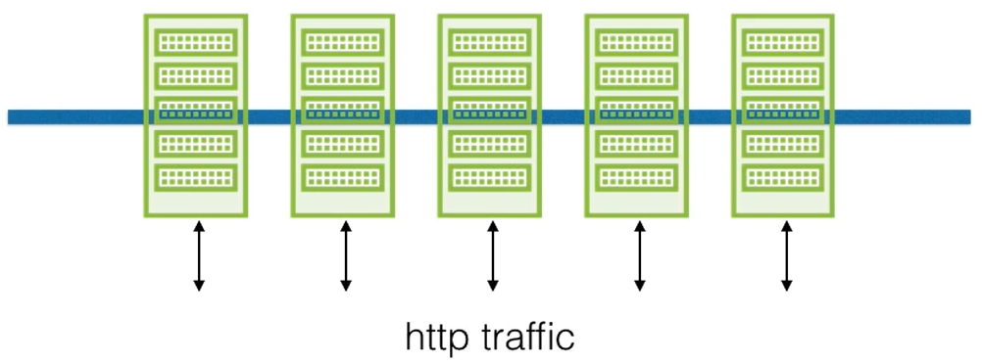
Different types of scaling - Horizontal
Horizontal scaling = Multiply the number of dynos to handle more traffic No scaling Scaling in place

Slide 42
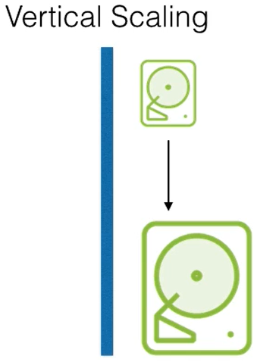
Different types of scaling - Vertical
Vertical scaling = Increase dyno resources (disk space, memory, CPU, etc.)

Slide 43
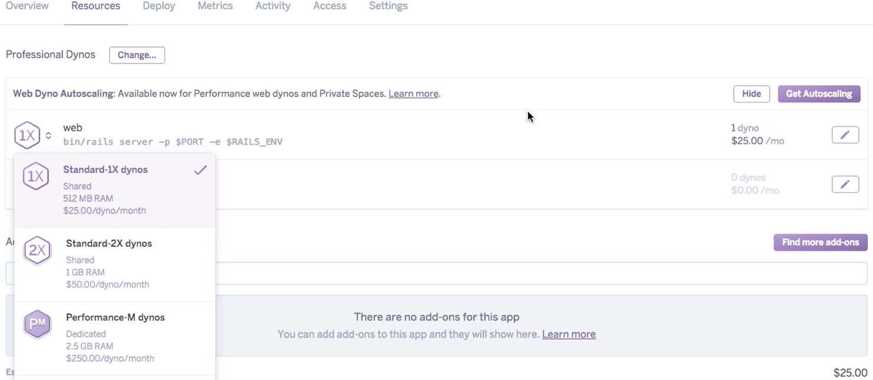
Vertical scaling with Heroku
It requires a dyno upgrade. You can pick exactly what you need:

Slide 44
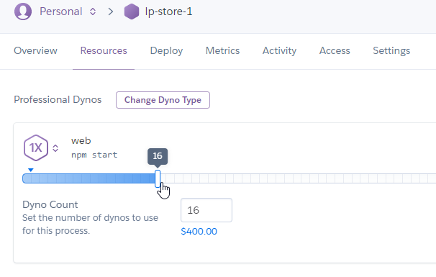
Horizontal scaling with Heroku
You can manually increase the number of dynos you want to use:

Slide 45
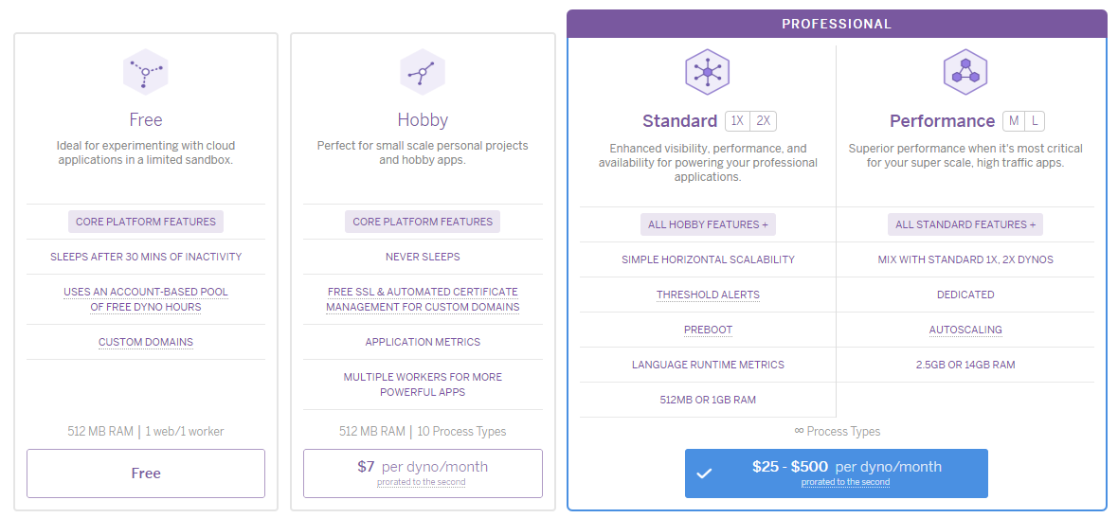
Heroku can handle scaling automatically
The most expensive plans have you covered with autoscaling:

Slide 46
Outline for today
Overview of Heroku
Introduction to Git and GitHub Deploying your applications using Heroku
Scaling your applications with Heroku Dynos
Heroku Connect Continuous Integration and Continuous Deployment with Heroku Supporting Heroku applications

Slide 47
Heroku Connect

Slide 48
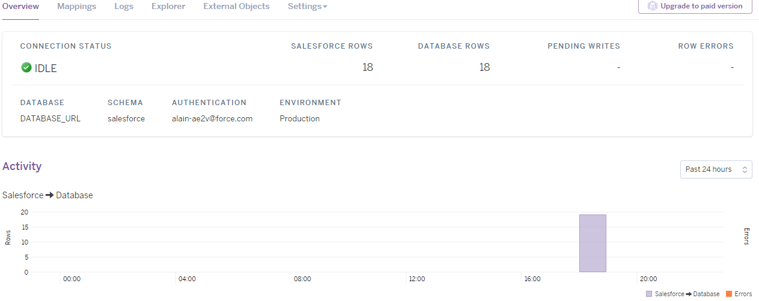
What is Heroku Connect?
Heroku Connect is an add-on that synchronizes data between your Salesforce organization and a Heroku Postgres database.
The synchronization works both ways:
- Any update in Salesforce data gets reflected in Heroku’s Postgres DB
- Any update in Heroku’s Postgres DB gets reflected in Salesforce

Slide 49
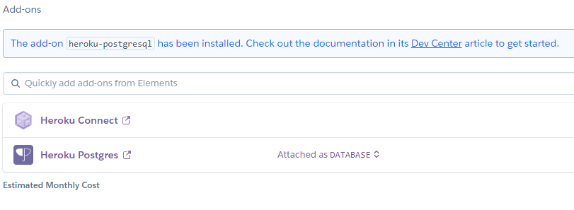
Add-ons
Heroku Connect is designed to work with a Postgres Database
Both Heroku Connect and Heroku Postgres are Heroku Add-ons

Slide 50
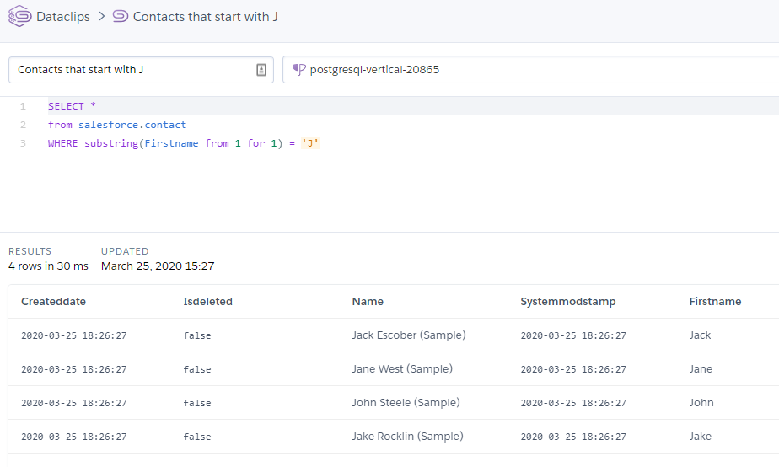
Heroku Dataclips
Heroku Dataclips enable you to create SQL queries for your Heroku Postgres databases and share the results with colleagues, third-party tools, and the public

Slide 51
Lab 5 - Using Heroku Connect, Postgres database, and dataclips
This lab is going to make us go through the entire process and practice with all of the concepts we’ve introduced earlier, such as add-ons, Heroku Connect, Dataclips, and scaling.
Follow the instructions at: https://devcenter.heroku.com/articles/getting-started-with-heroku-and-connect-without-local-dev
Work through all of the steps till you reach the “Summary” section.

Slide 52
Outline for today
Overview of Heroku
Introduction to Git and GitHub Deploying your applications using Heroku
Scaling your applications with Heroku Dynos
Heroku Connect Continuous Integration and Continuous Deployment with Heroku Supporting Heroku applications

Slide 53
Continuous Integration and Continuous Deployment with Heroku

Slide 54
Introduction to continuous integration (CI) and continuous deployment (CD)
Continuous Integration is a software development practice where members of a team integrate their work frequently, usually at least daily - leading to multiple integrations per day
Each integration is verified by an automated build (including tests) to detect integration errors as quickly as possible
Continuous Deployment is continuous integration followed by a deployment process (staging then production for instance).

Slide 55
Why continuous integration and continuous development?
Integration is hard, effort increase exponentially with: – Number of components/apps – Number of bugs – Time since last integration
As a result, integrating as often as possible is very helpful:
Makes the team conscious about the integration effort
Helps streamline the build process very early in the dev of a project
Gets the code to production as soon as possible

Slide 56
Benefits of continuous integration and deployment
Project Management
Detect development problems ASAP = Fail fast, fail often
Reduce risks related to cost, schedule, and quality
Code Quality
Code - Must - Compile
Measurable and visible code quality
Continuous automatic regression unit tests

Slide 57
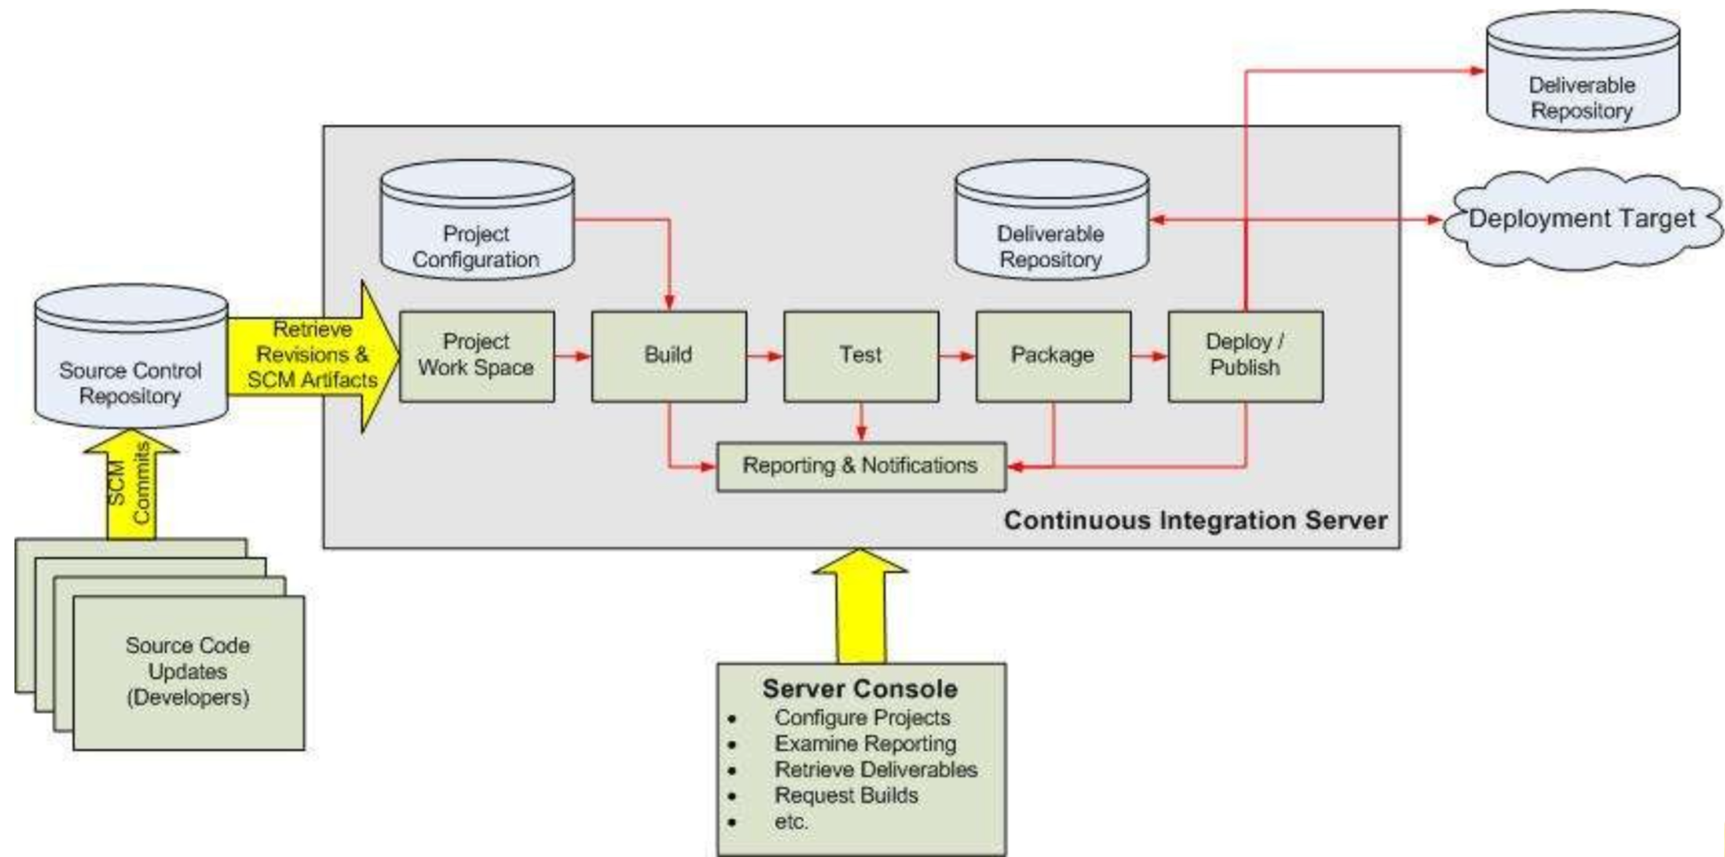
Continuous integration (CI) example

Slide 58
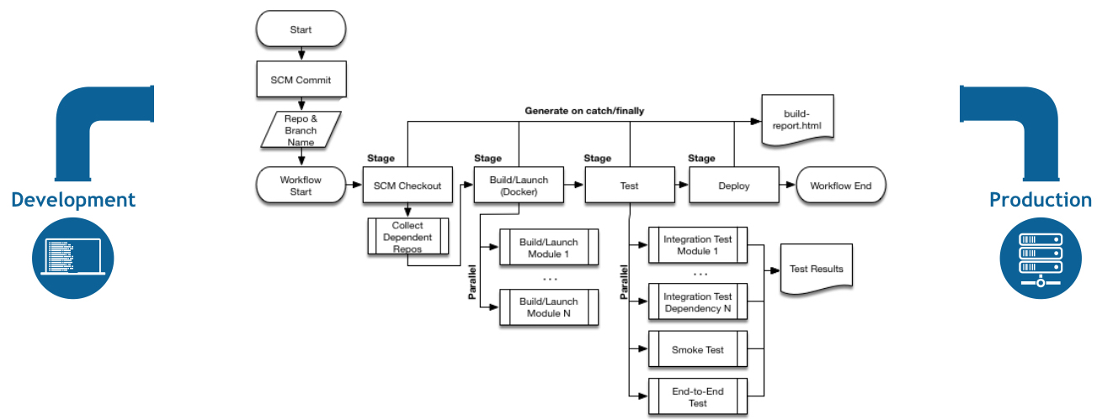
Continuous deployment (CD) example
Heroku can handle the entire pipeline from development to production

Slide 59
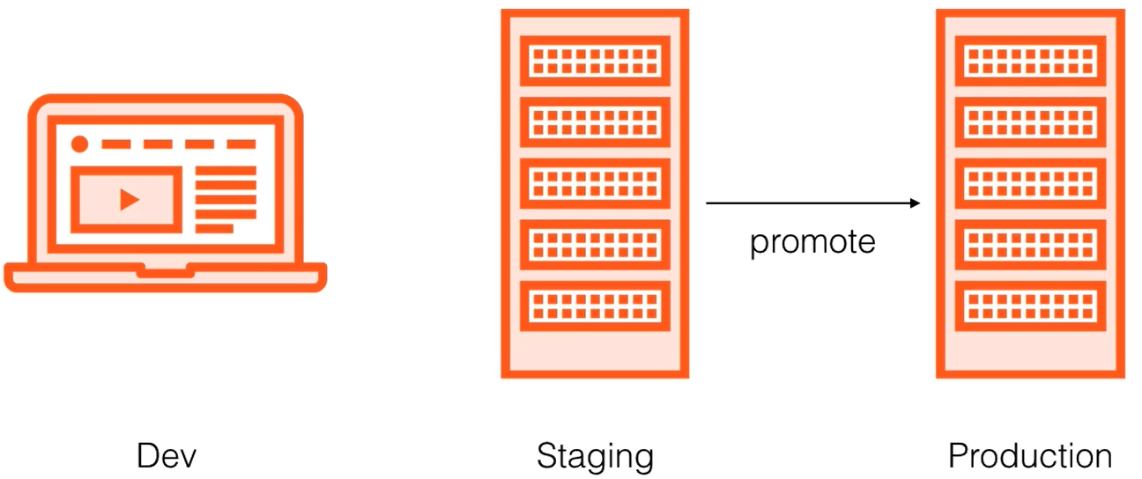
Heroku Pipelines
Heroku Pipelines are a way to move development code along multiple steps towards production.
For instance: Development - Review - Staging - Production
Each step in a pipeline is an independent Heroku app

Slide 60
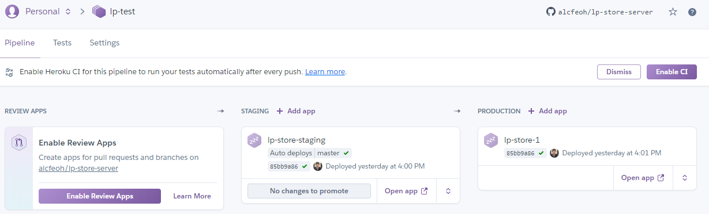
Heroku Pipeline Demo
Heroku Pipelines support continuous integration, review of pull requests, staging server as well as promotion to production.
All of that in one screen:

Slide 61
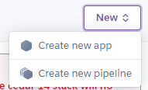
Lab 6 - Creating a pipeline with a staging environment
In this lab, we’re going to create a pipeline using the Heroku UI
To get started, navigate to: https://dashboard.heroku.com
Then click on the “New” button in the top right corner to create a new Pipeline: Then follow the different steps as instructed in the user interface. In case you need help: https://devcenter.heroku.com/articles/pipelines

Slide 62
Outline for today
Overview of Heroku
Introduction to Git and GitHub Deploying your applications using Heroku
Scaling your applications with Heroku Dynos
Heroku Connect Continuous Integration and Continuous Deployment with Heroku Supporting Heroku applications

Slide 63
Supporting Heroku applications

Slide 64
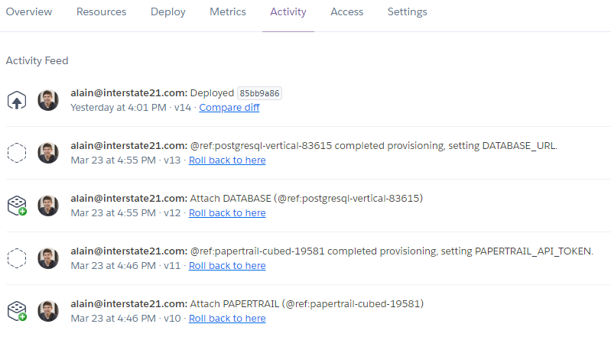
Monitoring Heroku Applications
Using the Activity tab on the dashboard of an application, one can see the history of changes made to an application and roll back to a previous version of the application:

Slide 65
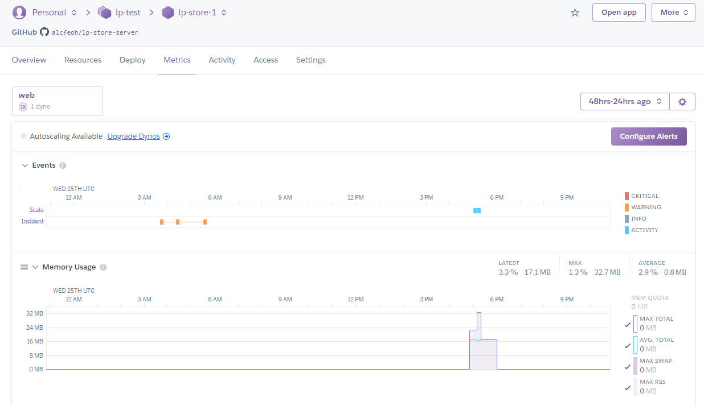
Monitoring Heroku Applications
Using the Metrics tab on the dashboard of an application, one can monitor memory usage, response time, as well as Dyno load:

Slide 66
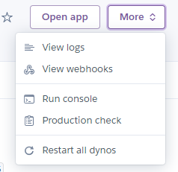
Supporting Heroku Applications
More interesting features are available on the “more” button Located in the top right corner of your Heroku application
Here you can access the logs, run a production check, as well as restart all dynos:

Slide 67
The settings tab
A lot of features can be found in the Settings tab:
SSL certificate management: Use Heroku’s certificates or your own
Custom domains management
Config vars: Environment variables for your application
Maintenance mode: Take the app offline temporarily
Delete app: Remove everything associated with that app from Heroku

Slide 68
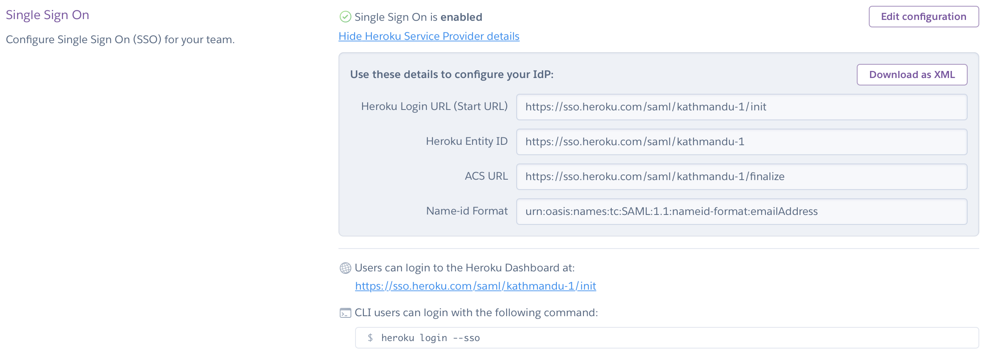
Single Sign-On Setup
Single Sign-On can also can be found in the Settings tab for Heroku Enterprise accounts
Major identity providers are supported: Auth0, Azure, Okta, OneLogin, Salesforce Identity, Ping Identity, Bitium, and more

Slide 69
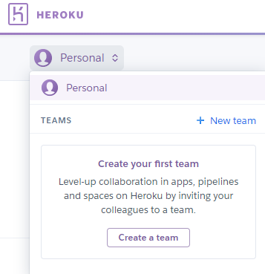
Heroku Private Spaces
Private spaces can be used to create white lists of IP addresses
This feature requires the creation of a team in Heroku:
A Spaces tab will appear in your team. That’s the place where you can create Private Spaces
Once a Private Space is created, its tab has a Network Tab where white lists of IP addresses can be managed
For more info: https://devcenter.heroku.com/articles/private-spaces

Slide 70
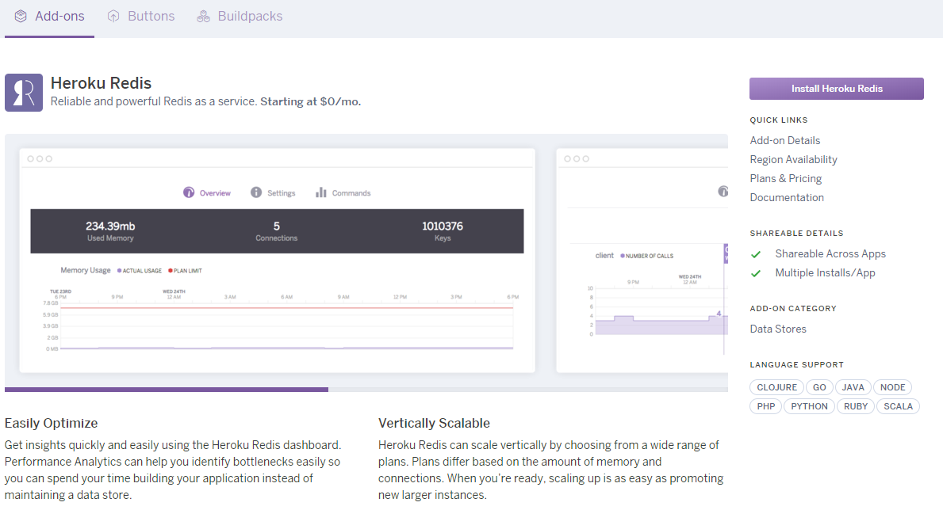
Heroku Redis
Heroku supports different databases as add-ons, such as Redis:

Slide 71
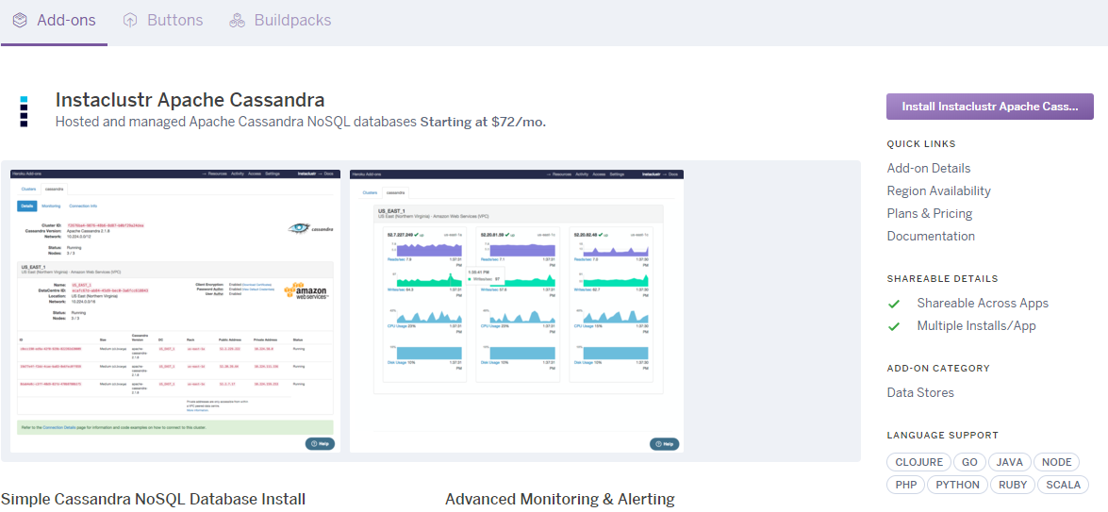
Heroku and Apache Cassandra
Apache Cassandra is another example of such DB add-on:

Slide 72
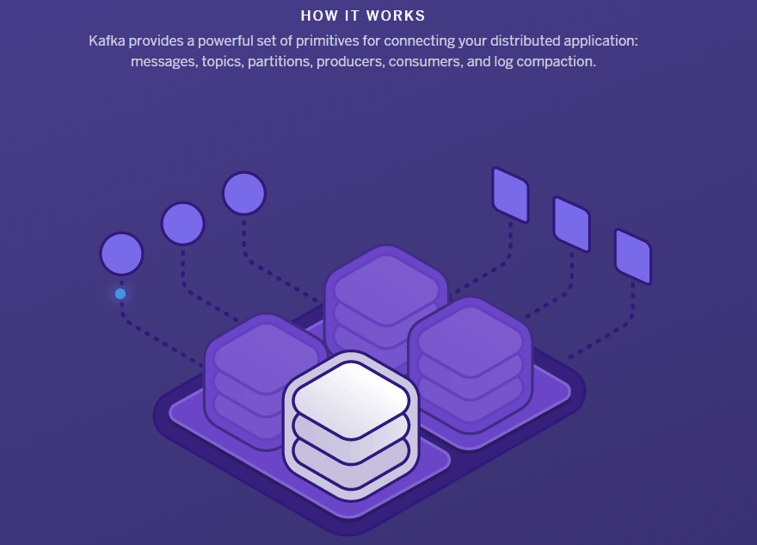
Heroku and Apache Kafka
Apache Kafka is also supported for complex streams of messages
Demo

Slide 73
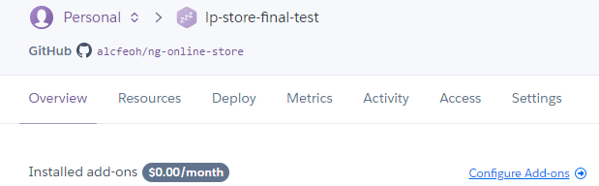
Lab 7 - Using the Redis Add-on
In this lab, we’re going to install and use the Redis add-on
To get started, navigate to: https://dashboard.heroku.com
Select one of your apps. In the Overview tab, click “Configure Add-ons”: Add the Redis Add-On. Check its Settings tab to see the access information to that database. Head to the Settings tab of your application. Reveal the config vars. What do you see?

Slide 74

Thanks for your attention
Feedback form:
https://www.surveymonkey.com/r/XPKCW2H
Thanks for your feedback!
al@interstate21.com

